Slide 1
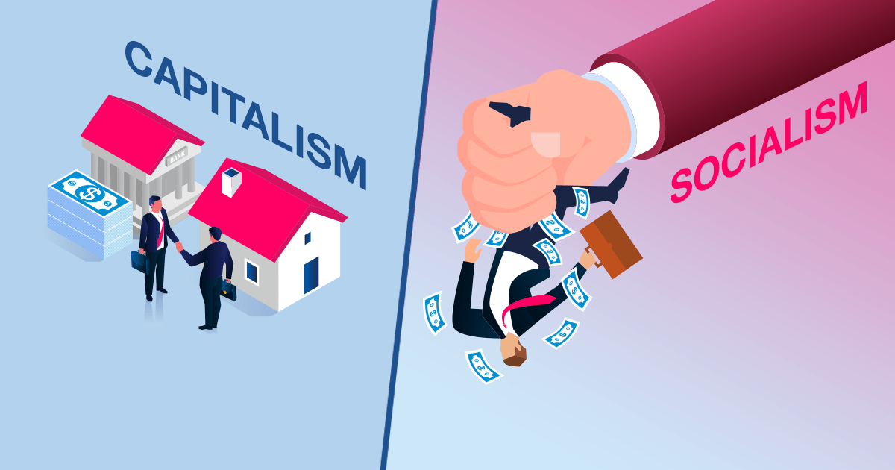


Pluralism, Crime & Socialism

Slide 2



Plural Society
A society where two or more racial or ethnic groups live but where there is limited mixing of cultures or intermarriage
Each group maintains some form of its own institutions, e.g. religion, family and education, etc.
The origin of Caribbean plural societies emerged from European slavery.

Slide 3
Challenges & Outcomes
Challenges
Politics ethnically aligned
Outcomes
Cultural sharing (customs, skills, knowledge, foods, styles of dressing, language, etc.)
Racial discrimination
Ethnic crime and violence
Community integration
Cultural diversity

Slide 4
Four (4) Sociological Theories of Crime
Strain Theory
Crime is conflict between people’s goals & means used to legally obtain same.
Social Process Theory
Crime is function of individual socialization
Social learning theories claim that crime is learned behaviour so through family, friends, peer groups influence people’s behaviour
Social Disorganization Theory
Examines urban conditions that affect crime rates
Social-Conflict Theory
Class warfare, radical feminism, or discrimination against women
People of low socioeconomic class has less opportunity to achieve their goals, so they commit crimes to meet their needs
Interactions people experience within their environment may lead them to commit crimes
Claim that high unemployment, high school dropout rates, low-income levels, & large numbers of single parents’ households contribute to crime
Left realism
Claims that most crimes are acts against individuals and not the state.

Slide 5
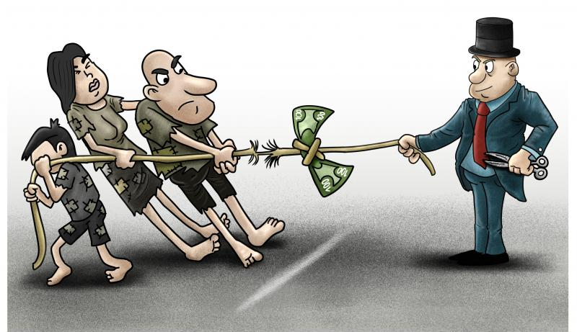
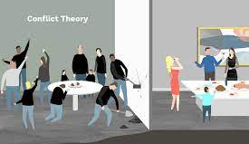
Peacemaking Criminology
protest against war becomes worse than war itself
Social Conflict
socially unequal groups, such as rich and the poor, competing for money and material goods, as becoming outright rebellion against the wealthy by the numerically superior poor.
Discrimination
Occurs not only happen along economic lines, but can be on race, ethnicity, gender, religion or political ideology.
Social conflict
keeps the lower classes poor and uneducated and makes the middle class compliant with the existing system so it does not slip into poverty.

Slide 6
Conclusion
Social conflict theorists see SOCIALISM as a way to end the class struggles by eliminating the economic advantages enjoyed by the upper class in society.
In criminology, the rational choice theory adopts a utilitarian belief that man is a reasoning actor who weighs means and ends, costs and benefits, and makes a rational choice.

